Slide 1
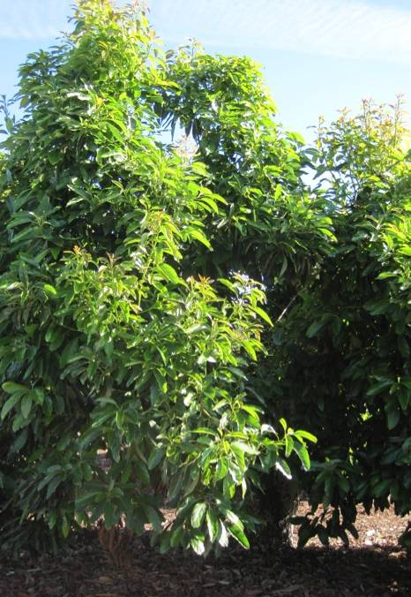
California’s AutoDR in Agriculture
Ken Nichols
VP, Energy Management
Notes:
Slide 1: Welcome and Intro Slide
KEY POINTS
Greetings, introduce yourself and your colleagues
Goal for today: tell you how PureSense is already working with customers to solve the irrigation management issues you face today
Transition:
First though, I’d like to start with a very brief overview of PureSense.

Slide 2
PMC Team
Name | Title | Phone | Email
Ken Nichols | VP | 503 438 8223 | knichols@puresnse.com
Elizabeth Goodman | Sales Operations | 559-972-4879 | egoodman@puresense.com
Bill Henry | Utility Analyst | 503-475-0391 | bhenry@puresense.com
Tim Henry | PMC Operations Manager | 559-799-2733 | thenry@puresense.com
Phon Sombat | Administration | 559-916-8928 | psombat@puresense.com
Notes:
Slide 1: Welcome and Intro Slide
KEY POINTS
Greetings, introduce yourself and your colleagues
Goal for today: tell you how PureSense is already working with customers to solve the irrigation management issues you face today
Transition:
First though, I’d like to start with a very brief overview of PureSense.

Slide 3
2012 Technology Incentives, AutoDR
Utility | AutoDR TI Incentives | 2012 to 2014 budget | Timing
PG&E | $200/kW | $26 MM | Proposals Now, applications Sep 2012
SCE | $300/kW | $35 MM | Accepting now
SDG&E | $300/kW | $9 MM | Accepting now
Example: 250 HP pump, max load 187kW, used 50% on peak equal 93.5 kW
Incentive for SCE would be 93.5 kW x $300/kW = $28,050.

Slide 4
Pumping Capacity of Well Pumps - California
There are approximately 26,000 pumps that would qualify
Source: USDA Census of Agriculture
Notes:
For entire year 2008

Slide 5
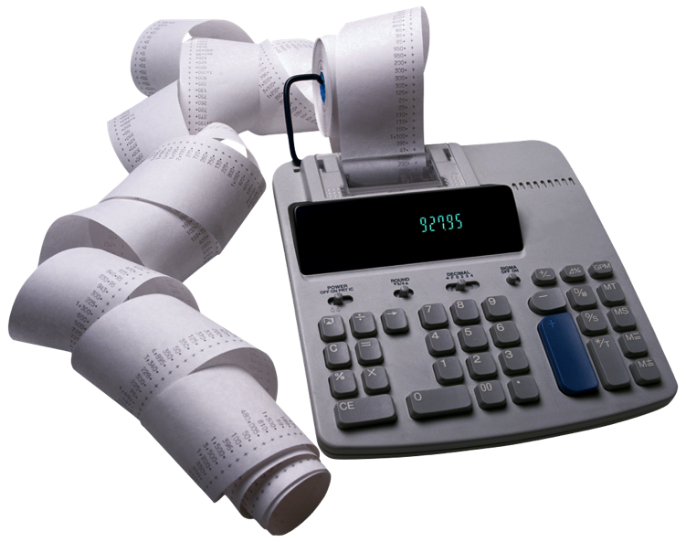
TI Application Process
WHO: Sales Representatives
WHAT: find Customers Interested in irrigation monitoring and/or pump control.
2. Identify sites:
. Pumps > 50HP
. Customer wants monitoring/control
. Willing to shut off duirng summer months
WHO: PMC team
1. Gather utility data on historical energy usage.
2.Technology Incentive Application, Customer signs, send to utility.
Time: Approval 1-2 months
WHO: Sales and PMC team
WHAT: Get from Customer:
1. CISR , Authroization to review utility bills
2. All utility accounts with HP > 50 HP. This might be front page of bills, or a spreadsheet with:
. Service Account
. Meter #
. Service address
. Company name
Step 1 –Fill Pipeline
Step 2 – Utility Accounts
Step 3 - Application

Slide 6
Close Process
Who: Sales Rep and PMC Rep
1. Meet with Customer and discuss results of utility incentive application.
2.Decide on project and budget
3. Get approval from customer to proceed.
Time: 2-3 Weeks
Who: PMC team
1. Invoice
2. Training
3. Support
Who: PMC Team
1. Field Survey
2. Confirm project aspects
3. Installation
4. Demand Response enrollment
5. AutoDR utility testing
Time: 1 month
Step 4 – Customer Approval to Proceed
Step 5: Field Survey Installation
Step 6: Invoice, & Support

Slide 7
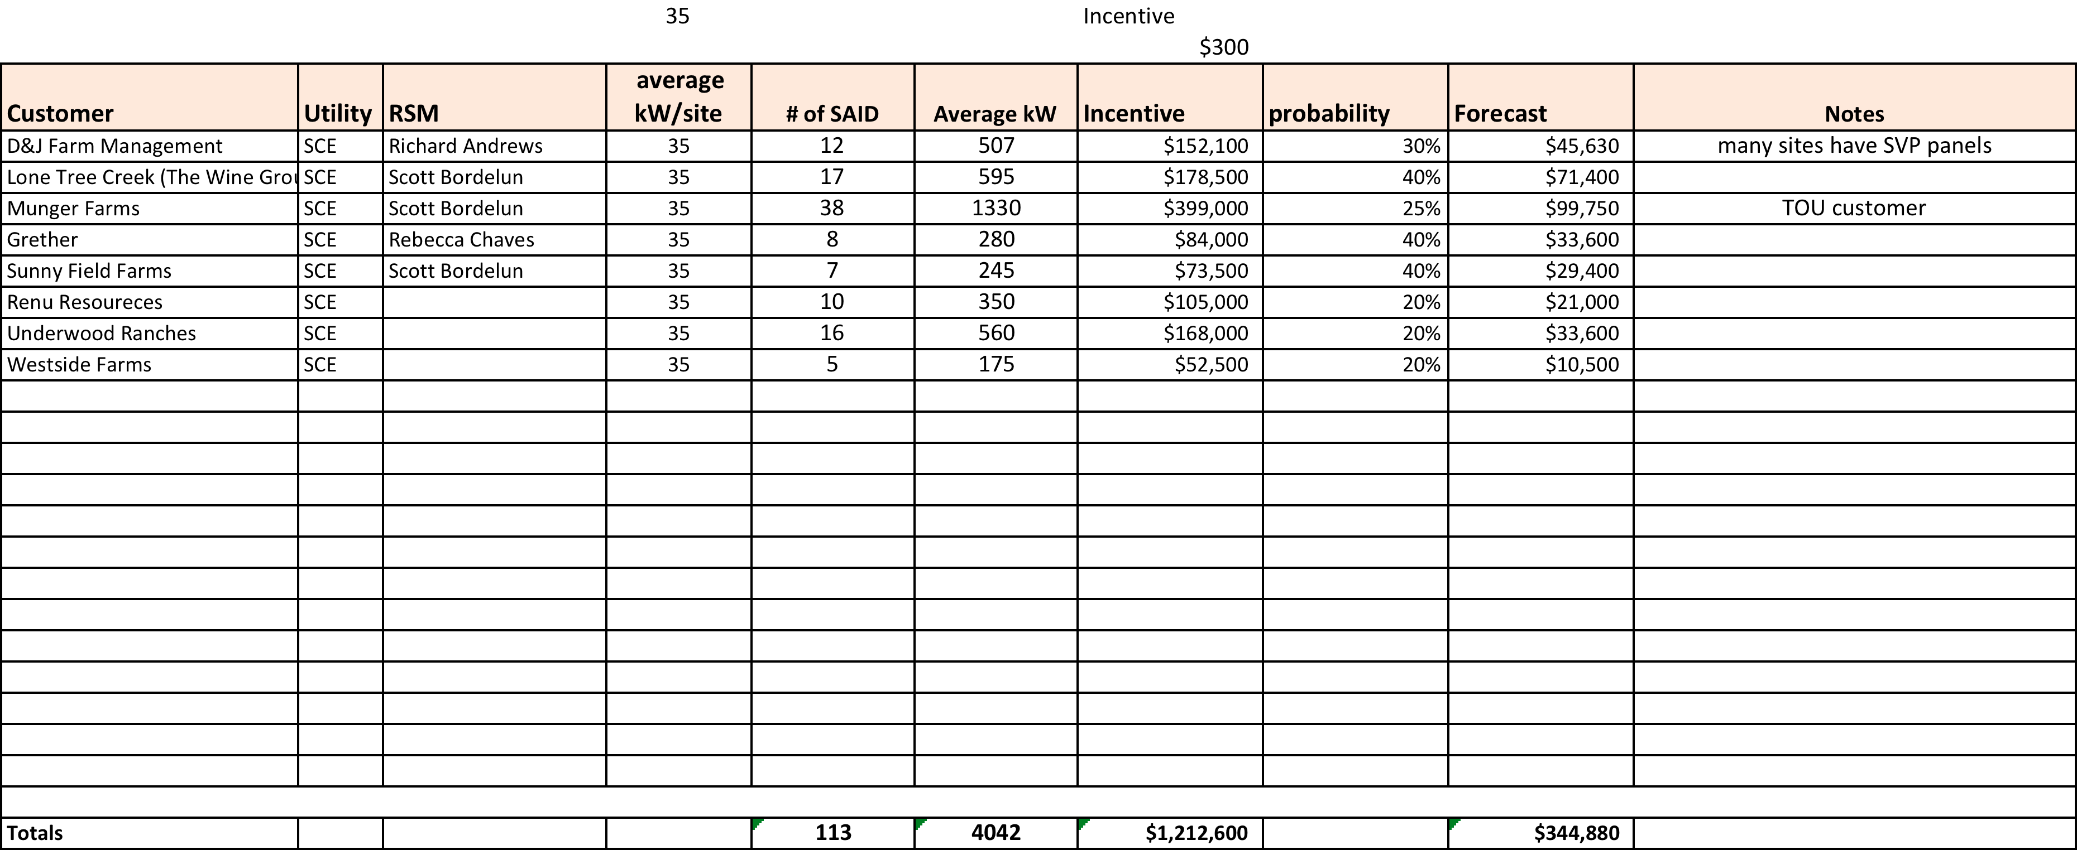
SCE 2012 Pipeline

Slide 8
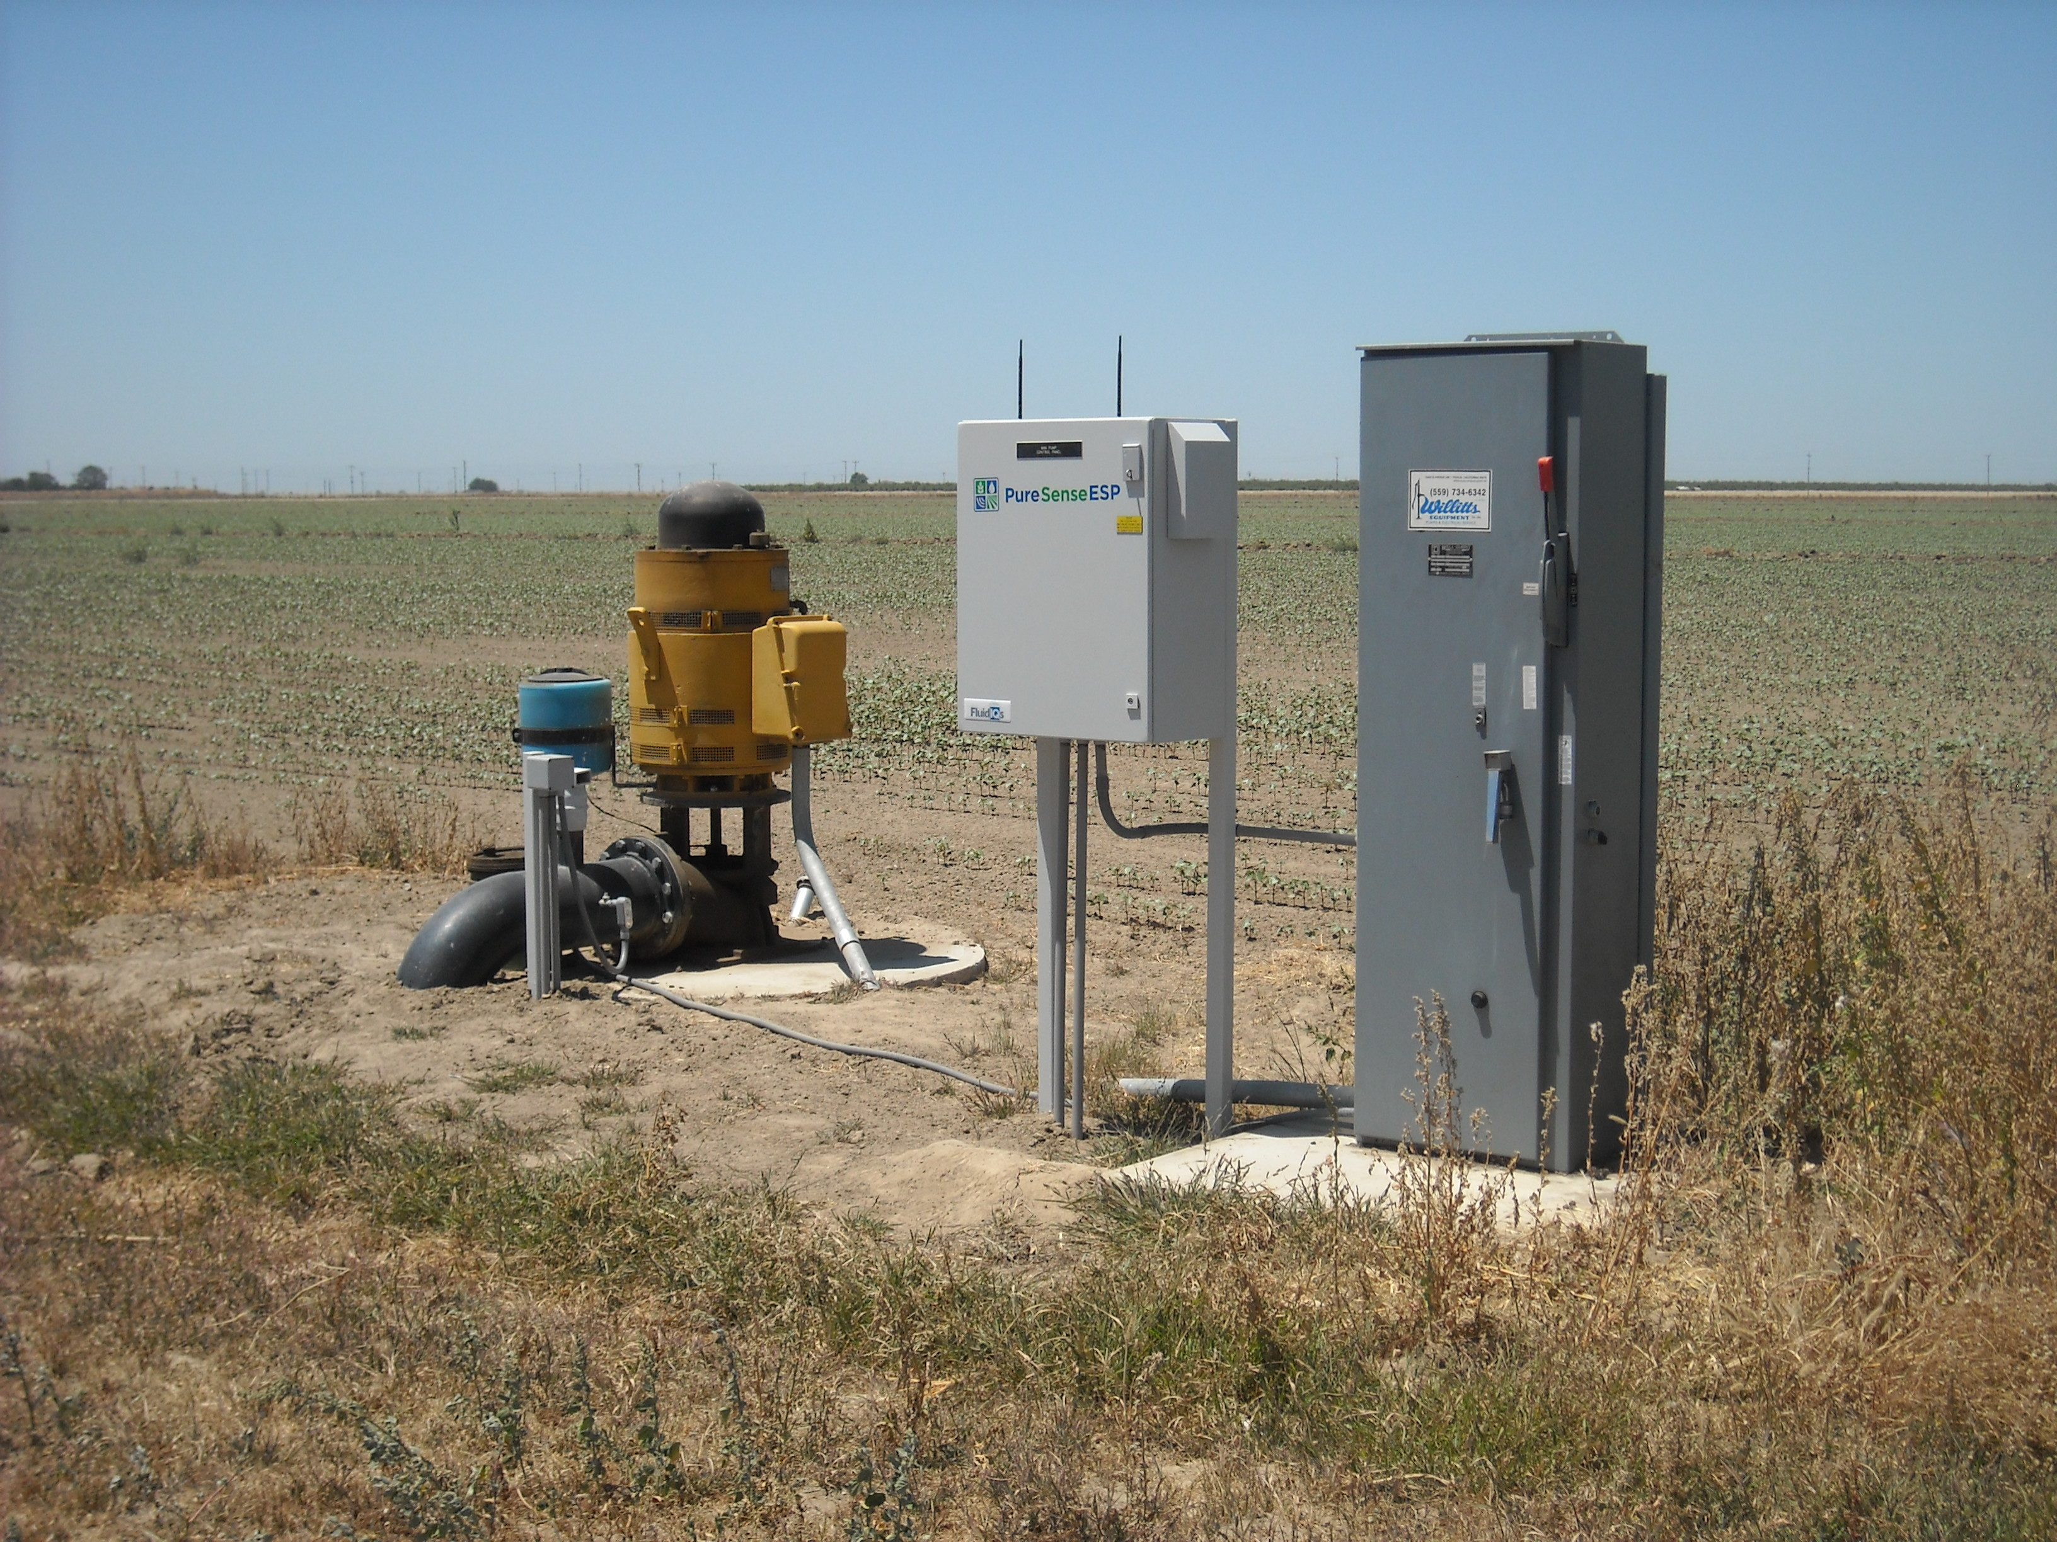
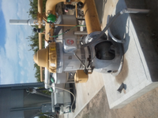
Merritt Farms, 94 sites

Slide 9
Merritt Farms
94 pumps total, SCE territory
Estimated on peak load > 5,000 kW
TI incentive > $900K
Sold PMC (94 units) and SMP (10 units)
Customer earns over $20,000/yr in DR incentives.
AutoDR solution

Slide 10
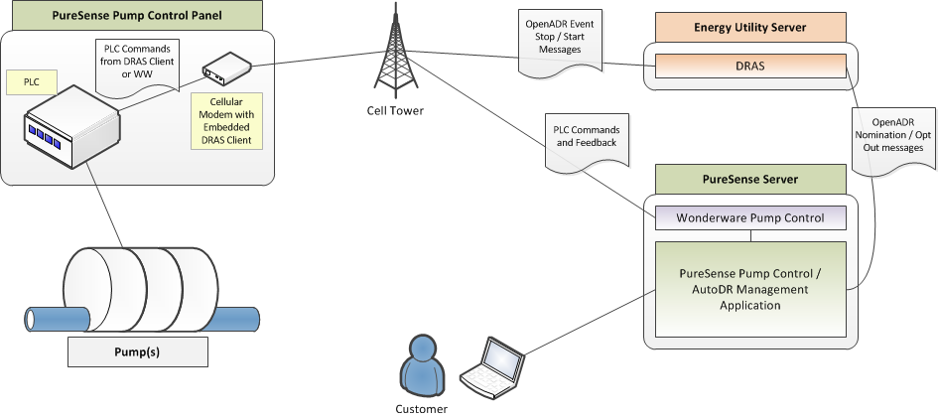
PureSense PMC
Sophisticated communication and controls enabling on/off, monitoring flow/levels/pressure, data management and integrated software.

Slide 11
PureSense ESP
Customers want equipment and other value but are often slow to adopt due to cash concerns
PureSense can sell equipment and service to the customer and have the utility pay for it; accelerating our growth
Utility wants power and is willing to pay for it because it’s in their interest

Slide 12
Terminology
kW: Kilowatts (1hp = .76 kW)
Demand Response (DR): reducing kW when Utility calls.
AutoDR: when the utility can reduce the load directly.
Baseline: Average amount of power used from the previous year’s 3 highest consecutive months.
Technology Incentives (TI): Incentives from Utilities to pay for initial equipment, installation, and controls.
Service Account (SA): Billing site that has 1 or more meters.
Aggregator: Independent third parties, authorized to work with a utility company to reduce the state's energy usage.
On-peak: Afternoons M-F, May to Oct, e.g., PG&E noon-6pm

Slide 13
Customer Criteria for utility incentives
Pump size > 50HP
Must have on-peak usage and willing to shut off for 1 to 4 hours during summer months.
Communicating Smart or Interval meter

Slide 14
Demand Events
Events can be called based for several reasons:
Heat
Price of energy
Utility need
Events, May 1 to Oct 31, noon-6PM during the week (no weekends or holidays)
2012, PG&E 3 consecutive days, 4 hr each

Slide 15
Application Steps
Customer Signs CISR (Customer Information Standardized Request) and provides all account and meter information
TI application submission
Utility or third party review and approval
Enroll in DR program (Constellation Energy)
Install PMC, train customer
Customer nominations 10 days prior to month start (e.g., May 20 for a June 1 start)

Slide 16
Customer example

Slide 17
PureSense products and service

Slide 18
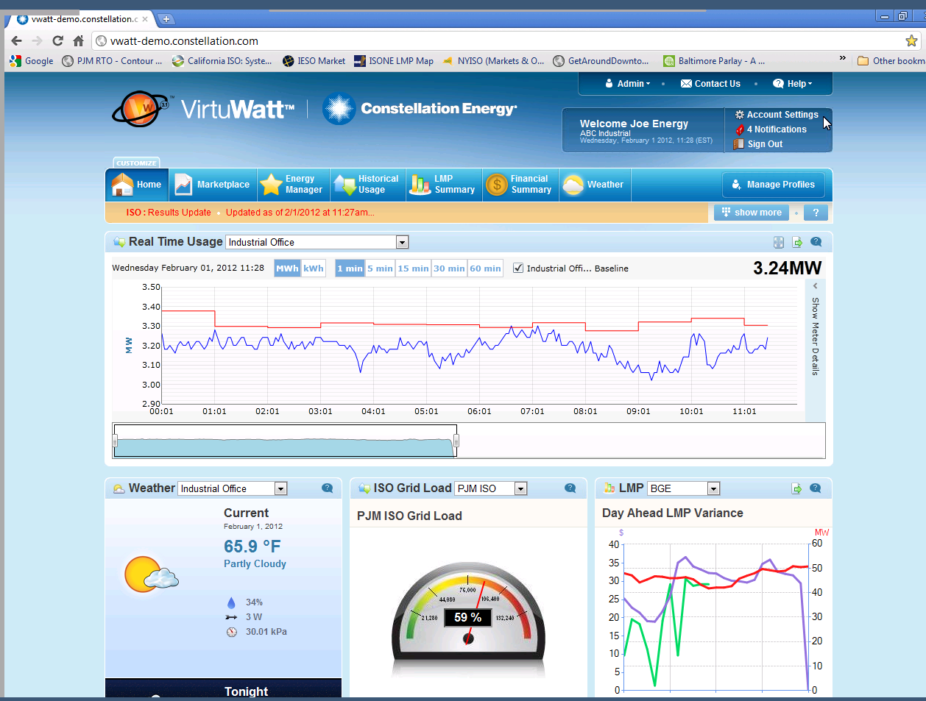

Slide 20
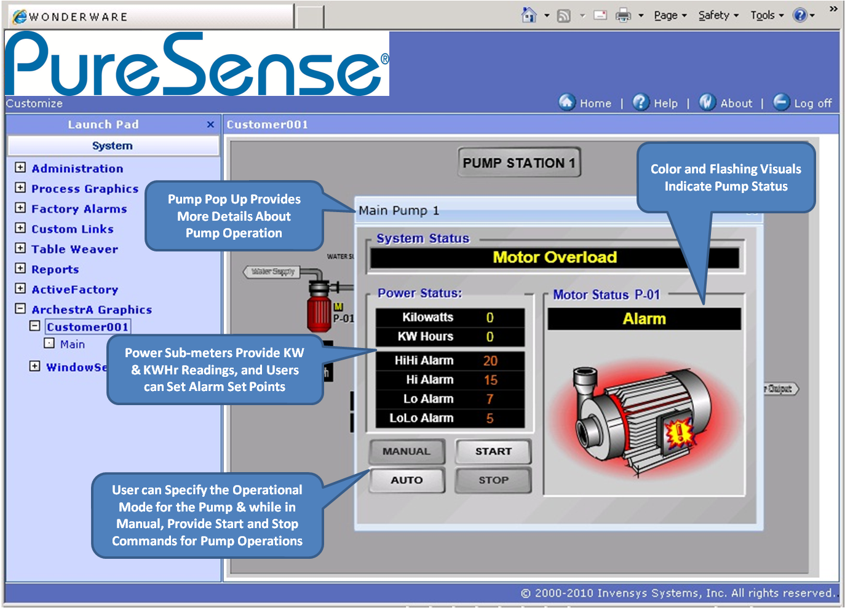

Slide 21
California Smart Energy: Carrots will turn to Sticks
Carrots = Incentives and performance pay
What: TI Incentives and Demand Response Program
When: through 2014
Who: Ag with large On Peak usage, > 32kW
Sticks = Time of Use (TOU) rates
What: Energy Costs will go up, unless control load
Opportunity to reduce costs on TOU
When:
Feb 1, 2011 >200kW and 12 months of data
Mar 1, 2013 <200kW and 12 months of data

Slide 22
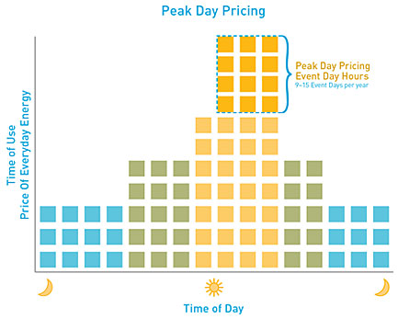
Time of Use vs. Peak Day Pricing
Notes:
1. The current Peak Day Pricing Event Day temperature trigger is: 94 °F
A five-station temperature average from weather stations across the PG&E service territory is used to determine when Peak Day Pricing Event Days are called. These five cities are San Jose, Concord, Red Bluff, Sacramento and Fresno.
2 California ISO system emergencies and market-price conditions may also lead to an event. Peak Day Pricing Event Days are most likely to be called during and around the summer season, though may be called on any date of the calendar year.
PG&E will call a minimum of 9 and a maximum of 15 Peak Day Pricing Event Days per year.
Features of Peak Day Pricing include:
• Bill Protection for the first year — so you can participate without risk. After a customer’s first 12 months on Peak Day Pricing, PG&E compares charges under the new plan to what would have been charged under the applicable time-of-use plan. If
annual costs have increased under Peak Day Pricing, the customer receives a credit for the difference on a subsequent bill and may elect to change to a more favorable rate.
• The opportunity to lower your overall electric bills if you can conserve energy during higher priced peak periods, especially on Peak Day Pricing Event Days.
• Flexibility to choose how your company participates. Options include Consecutive or Every-Other-Day Event participation, as well as Peak Day Pricing Event Day duration of either 2pm–6pm or 12pm–6pm.
• Day-ahead notification prior to Peak Day Pricing Event Days via your preferred method of communication.
Peak Day Pricing Eligibility
When your account(s) become eligible for Peak Day Pricing, a transition notice and custom rate comparison will be provided indicating your rate options. You will be able to decide which option is best for you. Customers eligible for Peak Day Pricing will
have the choice to transition to Peak

Slide 23
Why Utilities are doing this?
Utilities like PG&E and SoCalEdison:
Need to reduce peak electrical demand as
Peak gas fire plants cost $1,200/kW, and run as little as 50 hrs/year
Need a relatively small amount of power for a short period of time (6 hrs)
Cost effective (and easier) to reduce power needs vs. increasing capacity

Slide 24
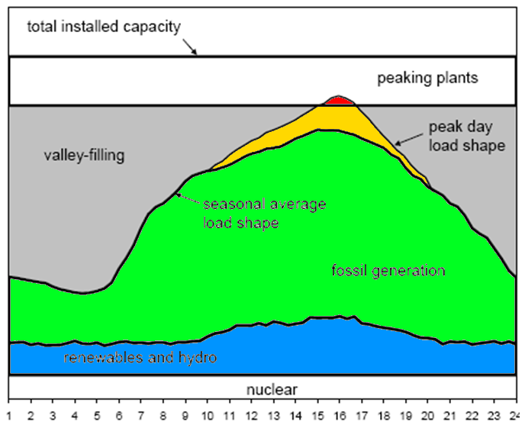
California Utilities Peak Demand
Demand Response Event
Renewable and hydroelectric

Slide 25
California Utility “On-Peak” Load Profiles

Slide 26
Aligning Grower Concerns with Utility
Farmers are generally risk averse
Crop loss due to under irrigation is a significant concern, can be catastrophic
Want control over turn on and ability to opt-out if needed
Without clear understanding of available water there is no comfort level

